Slide 1
Luck, Machine learning and IEMS
You do need all three of them
Diego Klabjan and his research team

Slide 2
Do you Know?
History of Google – Larry Page and Sergey Brin
  Could not patent page-rank
    Found an investor by coincidence
  Tried to sell the company
    In 1998 to Yahoo and Atlavista
    In 1999 to Excite
      Number two search engine behind Yahoo
    Offers were rejected
We all know the rest of the story
https://www.memecenter.com/fun/1798643/google-yahoo-or-bing

Slide 3
IEMS, ML, and …
https://twitter.com/RFIDinfo/photo
RFID bnelson ML
2008
2009
present

Slide 4

Research Team
PhD students
  Theory and practice
Post-doc
Huge lab with heavy duty equipment

Slide 5
Deep Learning Theory

Slide 6

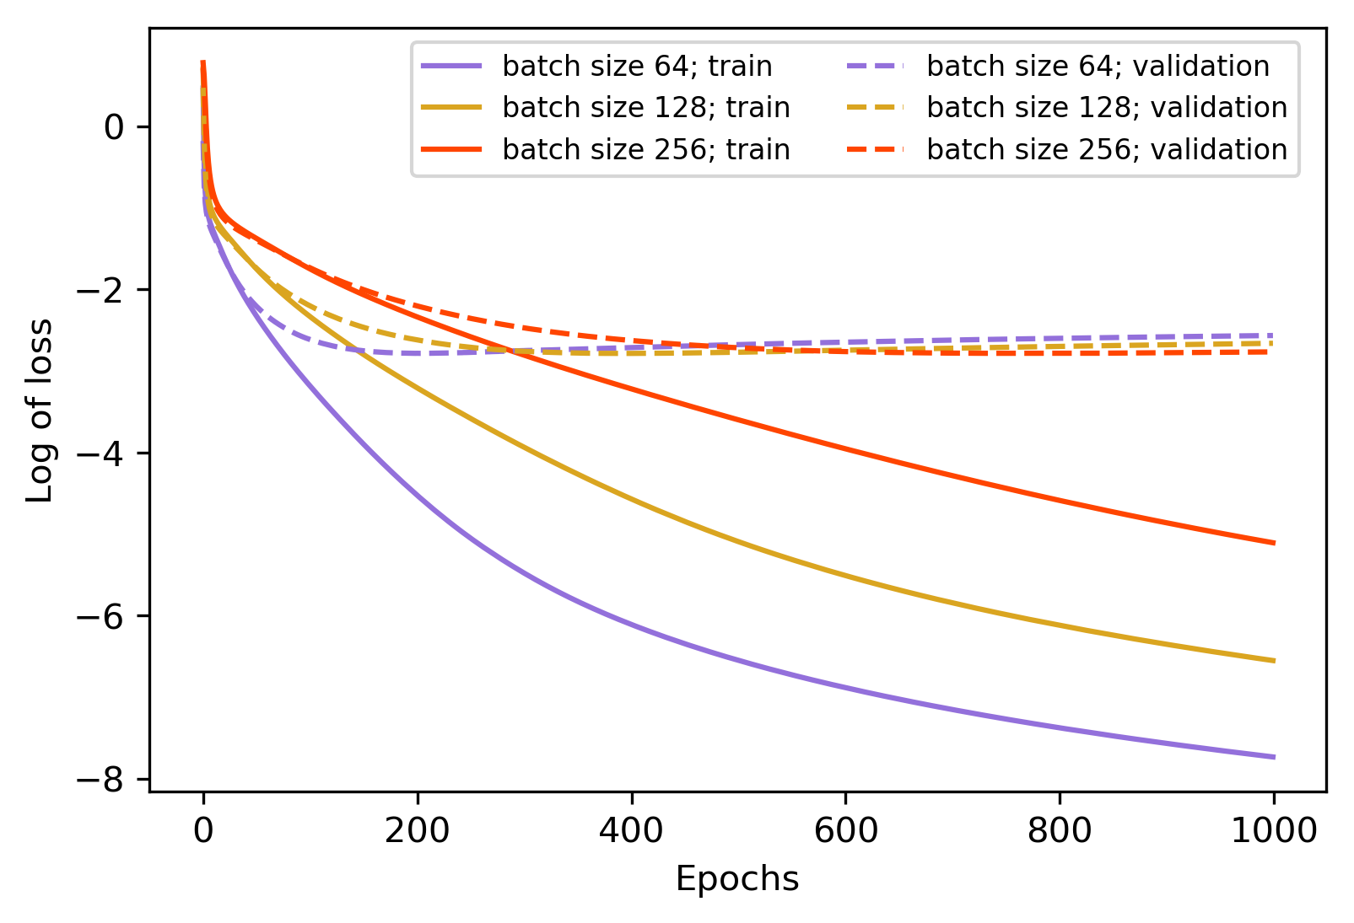
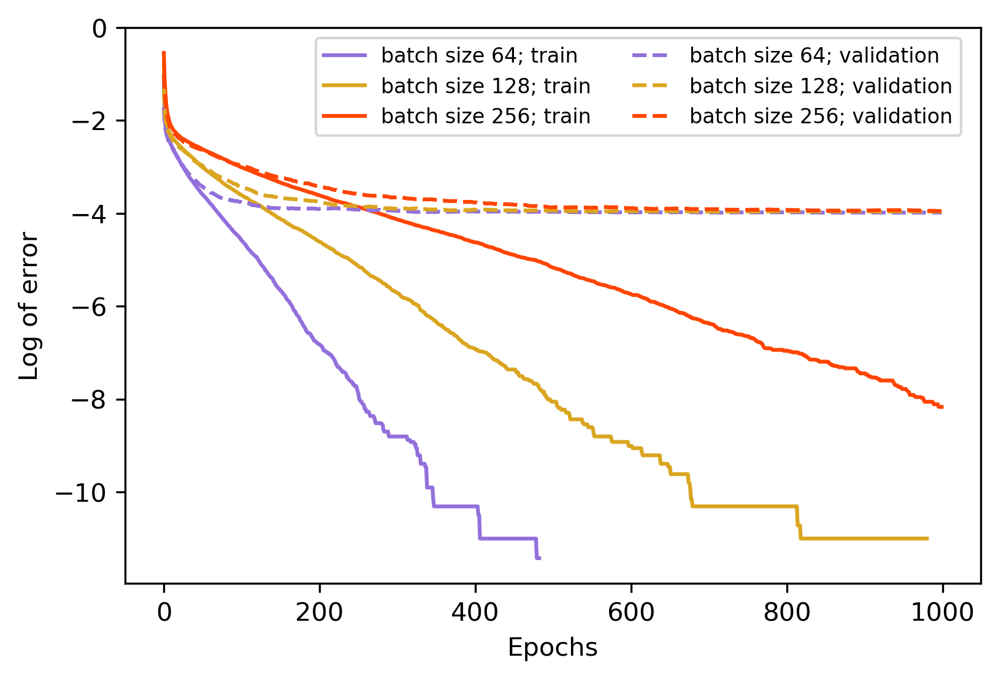
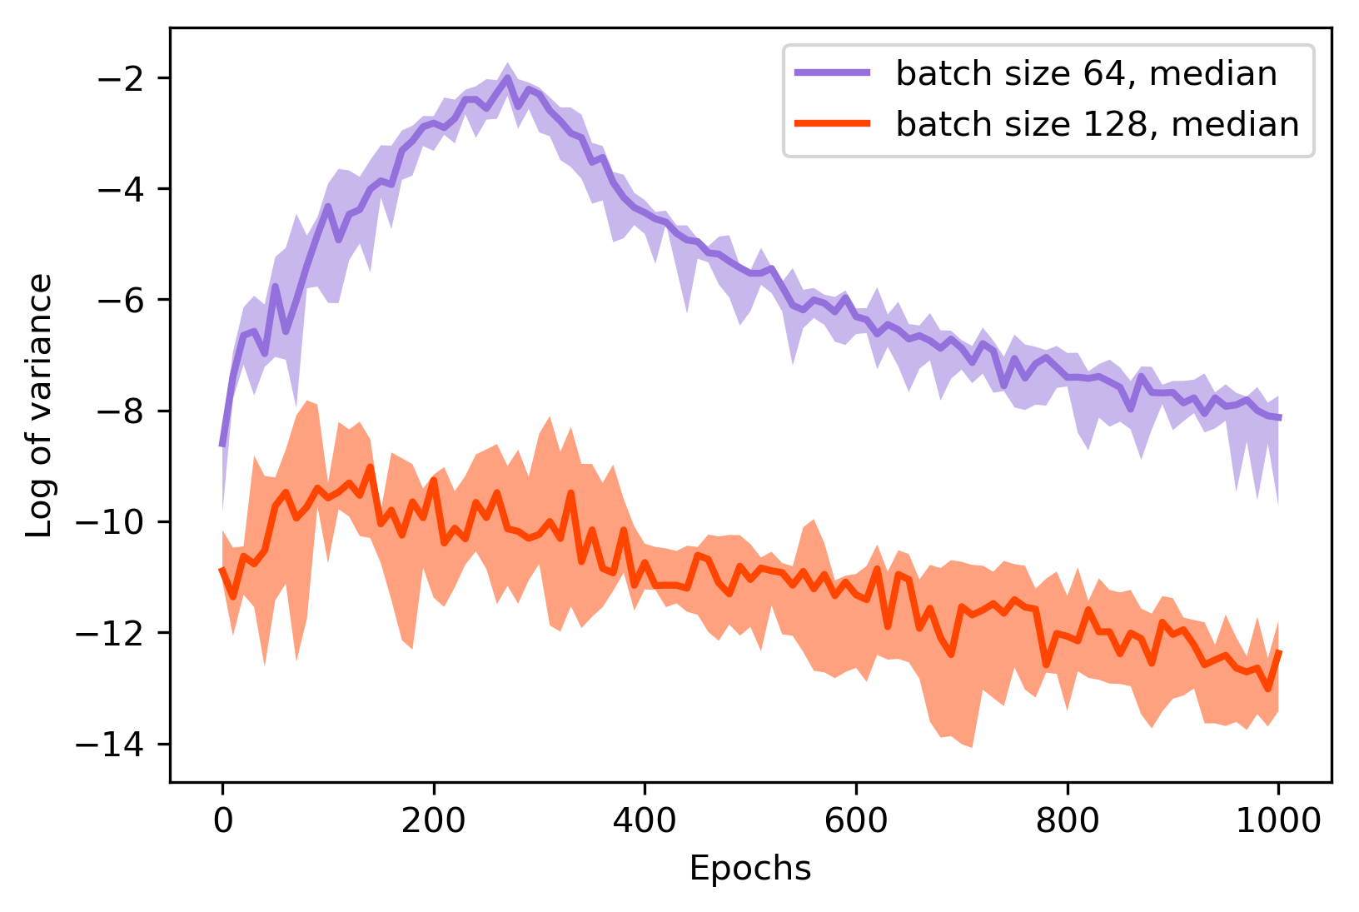

Variance of Stochastic Gradient Estimators
Stochastic gradient descent (SGD) and SG estimator:
Linear regression and two-layer linear network
  Decreasing functions of mini-batch size $b$

Slide 7
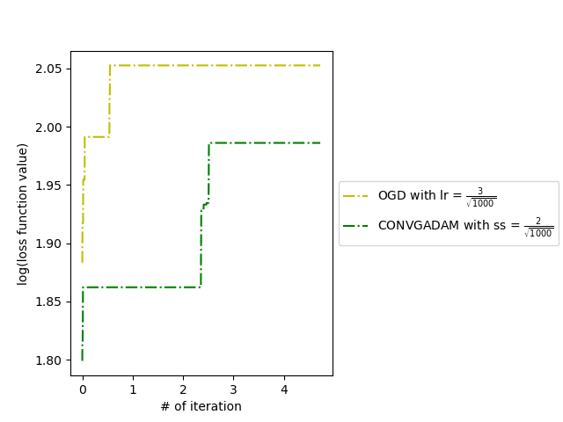
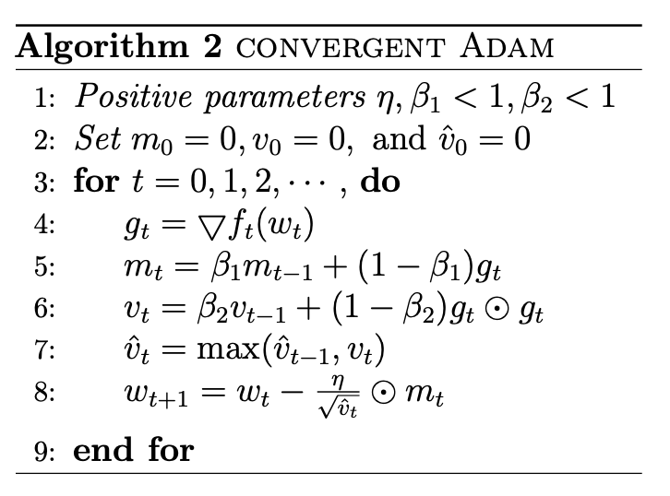
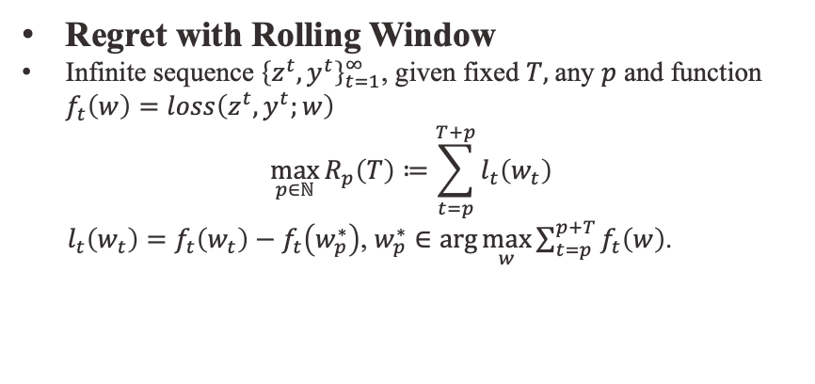
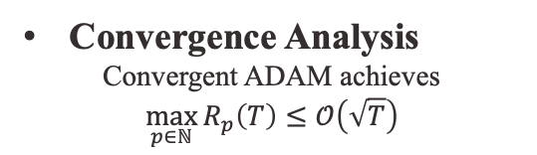
Online ADAM
Regret with Rolling Window
Infinite sequence ${\left\{z^{t},y^{t}\right\}}_{t=1}^{∞}$, given fixed $T,$any $p$ and function $f_{t}\left(w\right)=loss\left(z^{t},y^{t};w\right)$
$$\max_{p∈ℕ}{R_{p}\left(T\right)≔\sum_{t=p}^{T+p}{l_{t}\left(w_{t}\right)}}$$
$l_{t}\left(w_{t}\right)=f_{t}\left(w_{t}\right)−f_{t}\left(w_{p}^{∗}\right)$, $w_{p}^{∗}∈\text{arg}\max_{w}{\sum_{t=p}^{p+T}{f_{t}\left(w\right)}}$.
Convergence Analysis
Convergent ADAM achieves
$$\max_{p∈ℕ}{R_{p}\left(T\right)≤𝒪\left(\sqrt{T}\right)}$$
Algorithm
$$×{10}^{6}$$

Slide 8


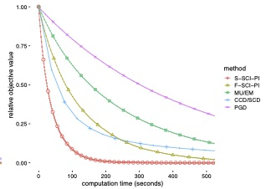


Scale Invariant Problems in Machine Learning
Scale Invariant Problem
  PCA, Estimation of Mixture Proportions, ICA, GMM, KL-NMF
Scale Invariant Power Iteration
  Computationally more efficient
  Often yields better solutions
KL-NMF Subproblem

Slide 9
Deep learning models and algorithms

Slide 10
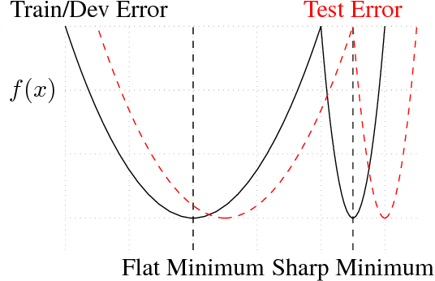
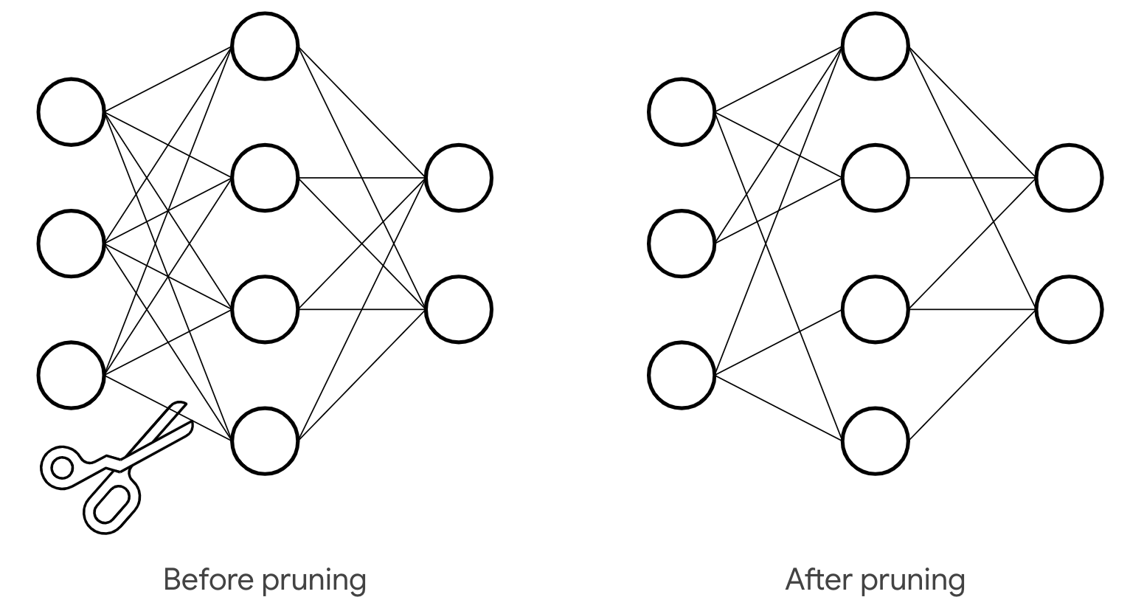

Network Compression with Kronecker Factored Approximate Curvature
Pruning neurons from the original network to obtain a smaller network
  Small network flat local minima
  Generalizes better
Flatness $≈$spectral radius of Hessian $≈$ KFAC
Taken from Keskar et al. (2016)

Slide 11
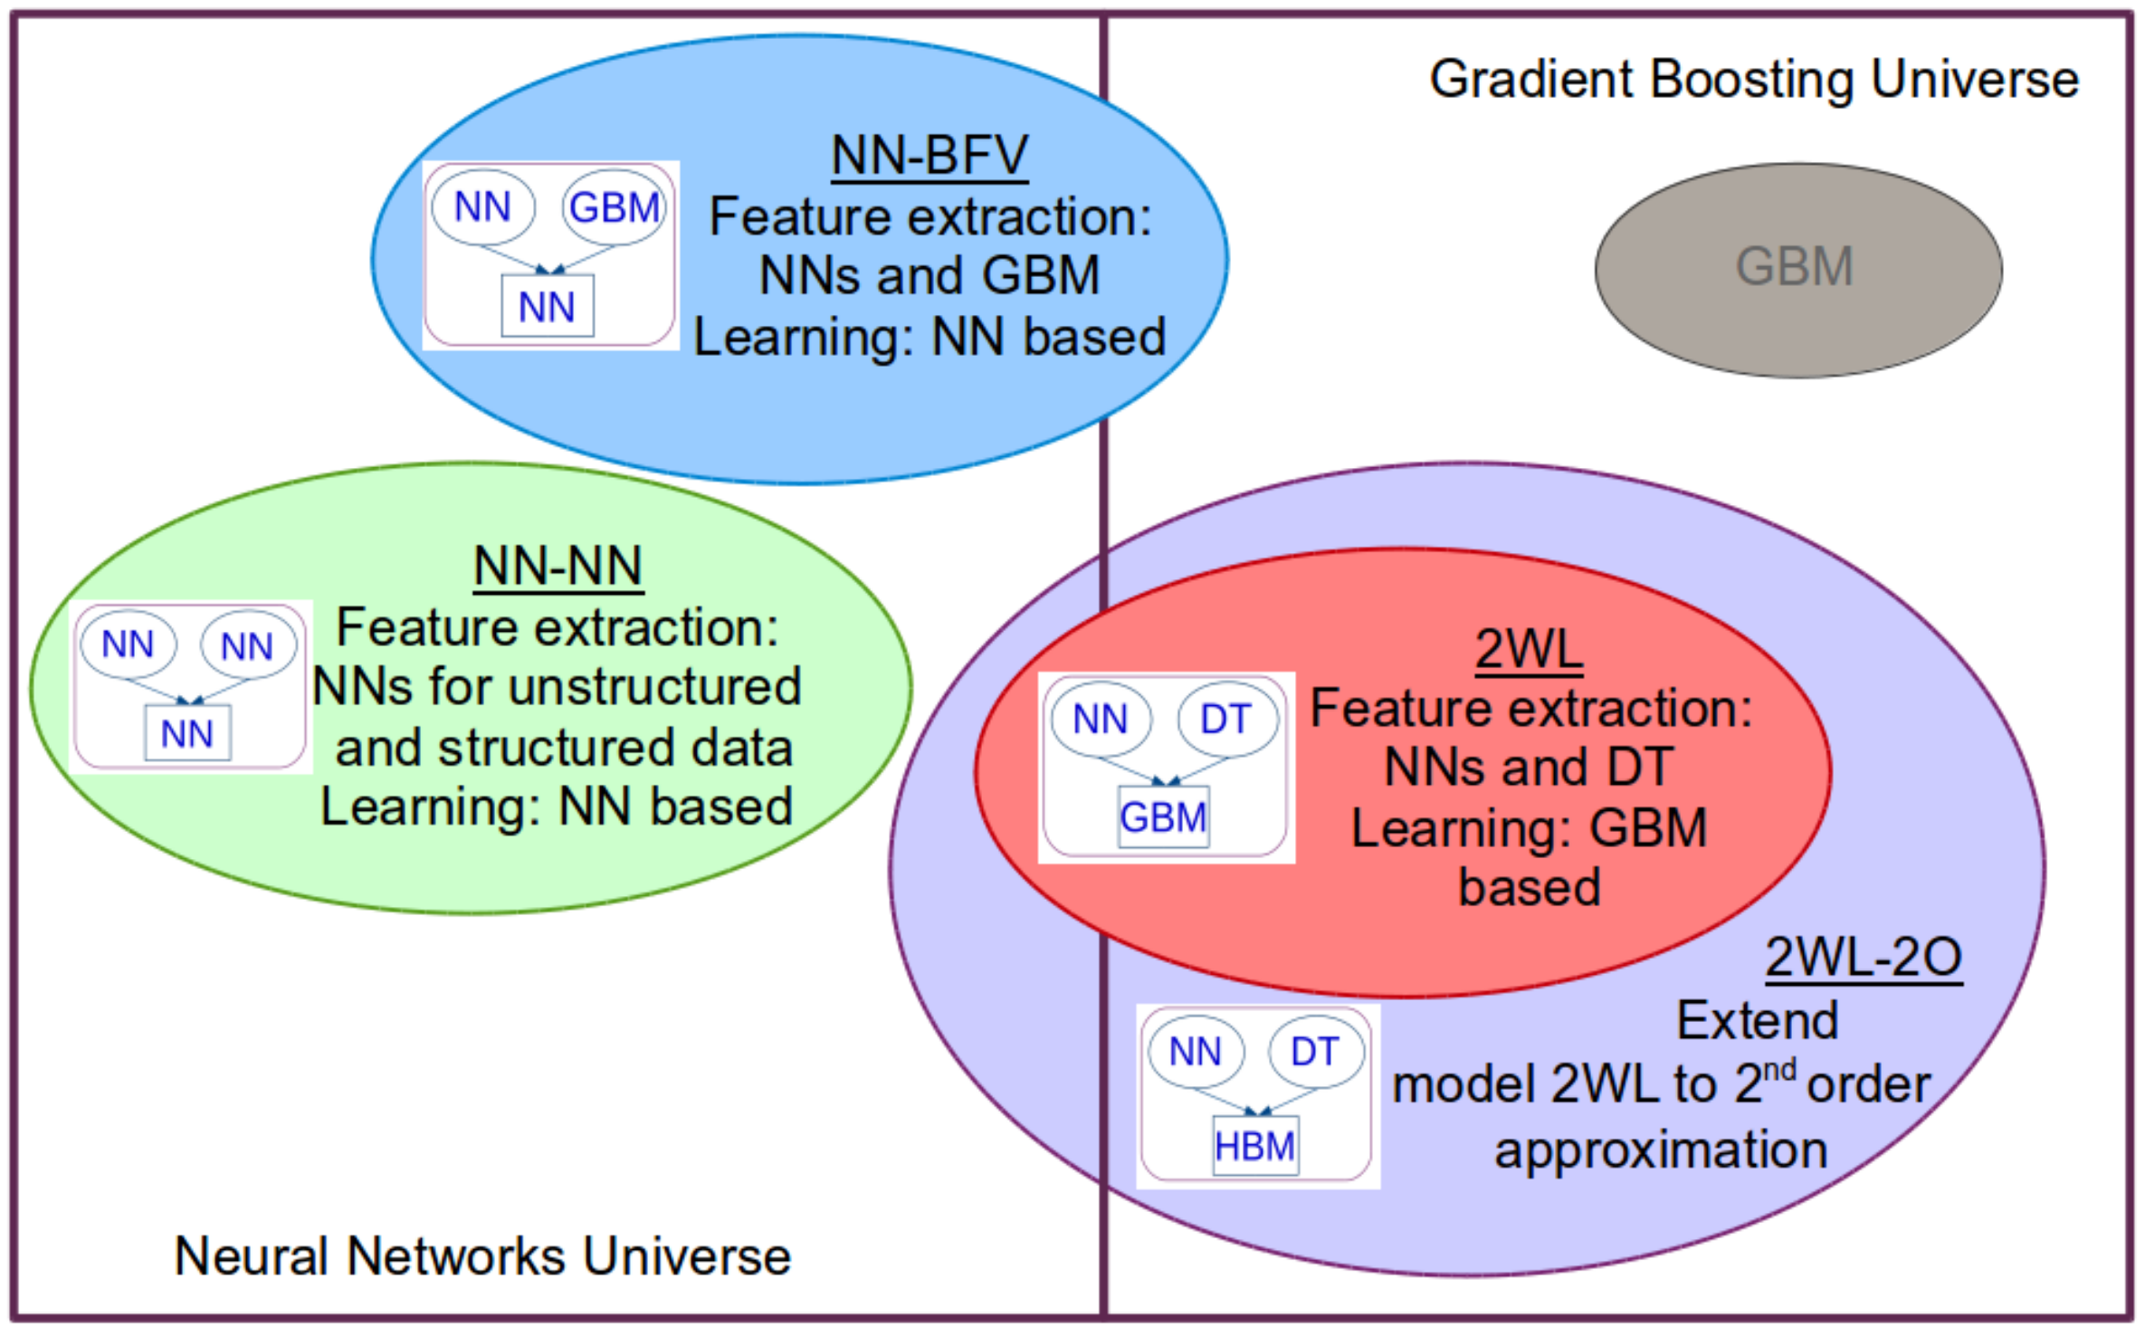
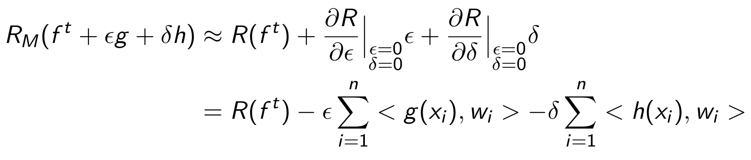
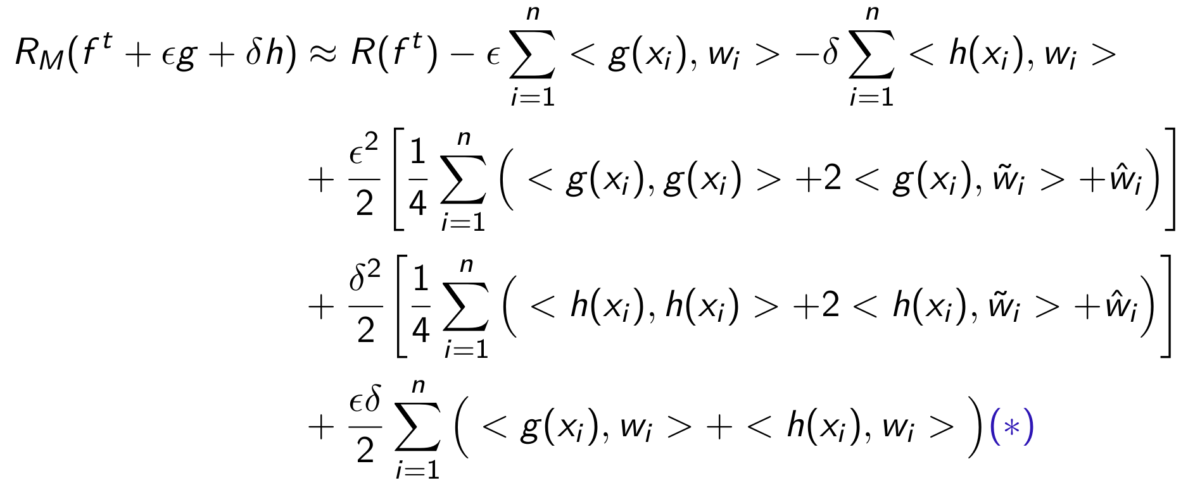
Boosting for Multi-Modal Data
First order
Second order

Slide 12
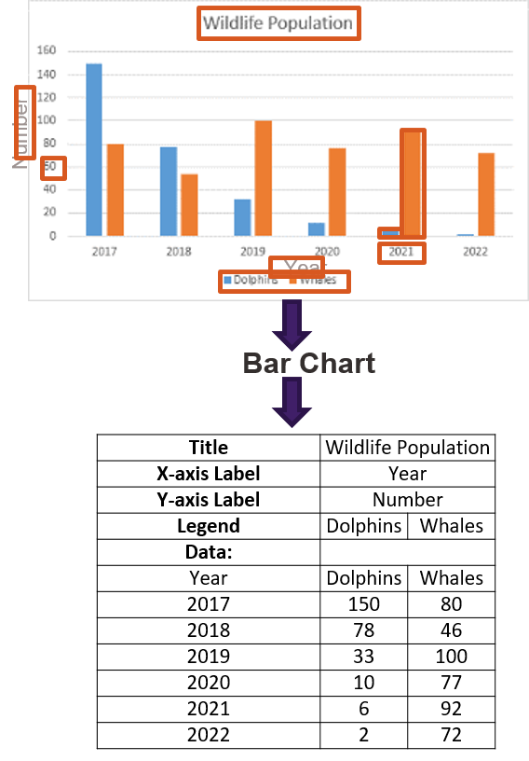
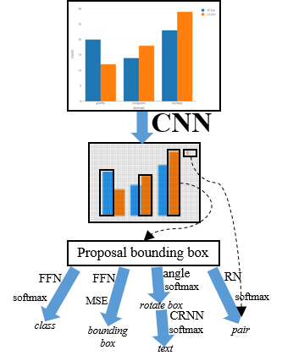
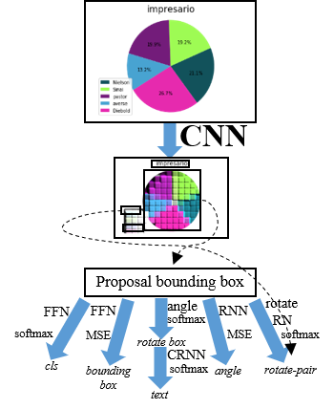
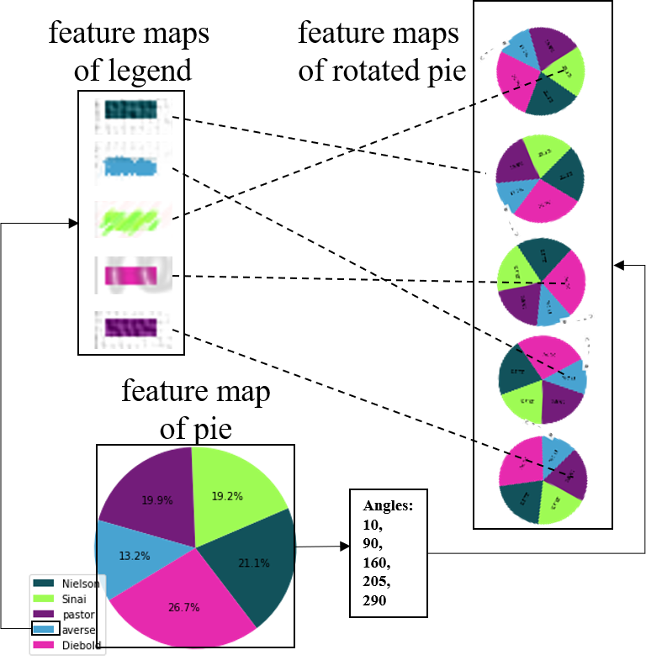
Data Extraction from Charts via Single Deep Neural Network

Slide 13
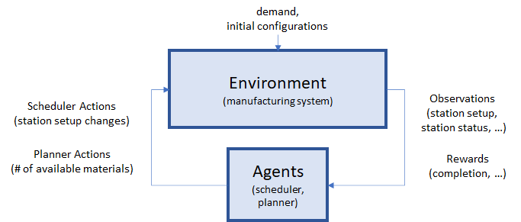
Agile Production Planning by RL
Formulate planning and scheduling tasks in a manufacturing system as a multi-agent reinforcement learning problem
  Higher level RL for daily demand
  Lower level RL for scheduling
    Multi agent
    Each agent controls
    a group of machines

Slide 14
Deep Learning Model serving

Slide 15
DELOS
DEep Learning mOdel Serving

Slide 16
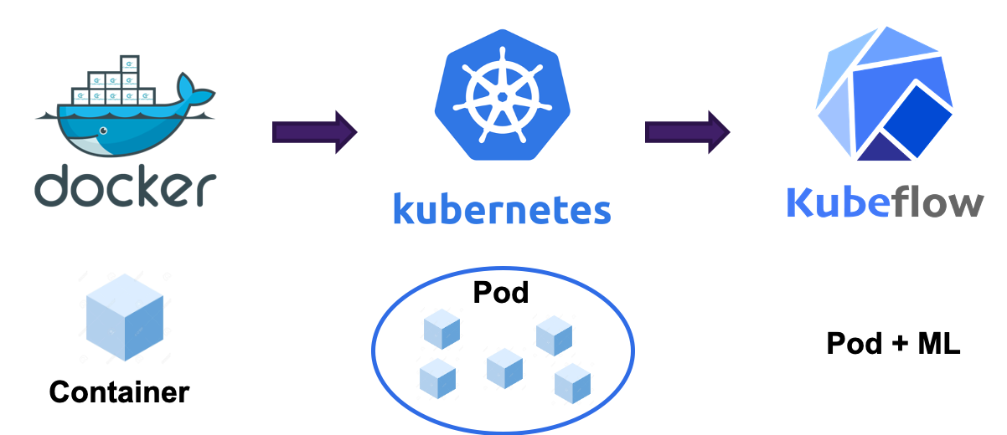
System Running Environments

Slide 17
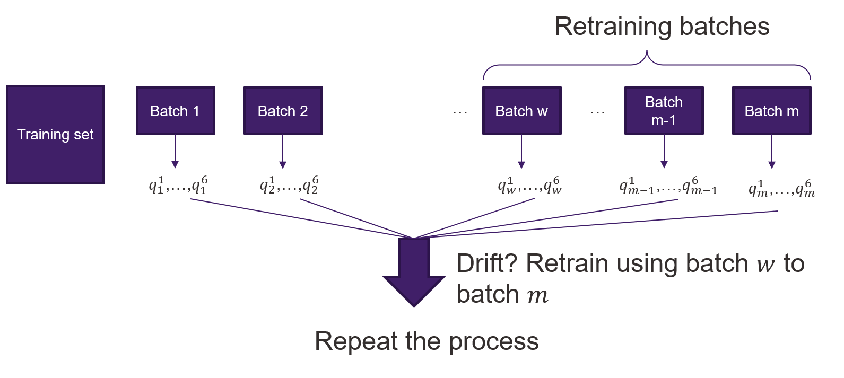
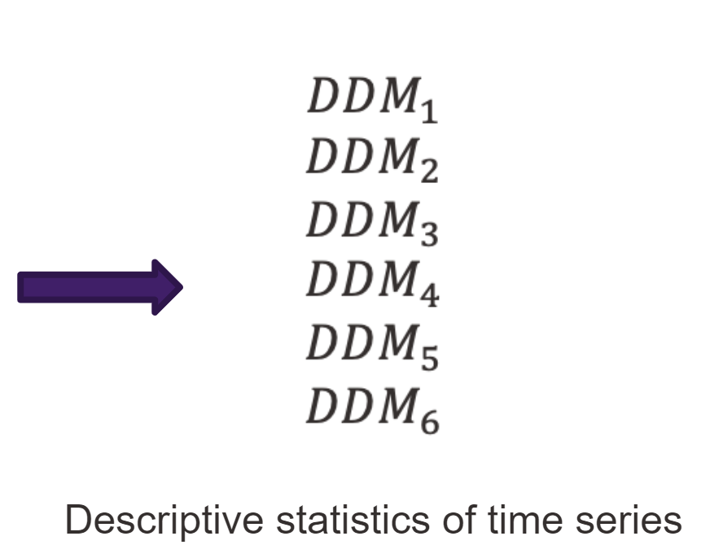
Concept Drift Detection
Incoming data distribution may change and causes performance degradation in model serving
Design drift detection algorithm
  Monitor model performance
  Decide if data has changed
  Data to be used to retraining
Ensemble of drift detection modules to ensure robustness
  Each score series has an independent drift detection mechanism
  Each series captures different characteristics of data, e.g. error rate
  Tailored majority voting to decide drift
Consistent outperformance over
state-of-the-art methods

Slide 18
Retraining
Training sample selection by using multi-arm bandit
  Reward of mini-batch is reduction in loss
Cope with catastrophic forgetting
  Additional term in loss
Efficient optimization
  Cluster weights
  Optimize only a given cluster
    Use multi-arm bandit
  Increased generalization

Slide 19
Statistical learning

Slide 20
MAB and RL Exploration
Several methods to perform exploration
  Espilon-greedy, boosted Q-networks, RND
EXP3 and EXP4 require agents
  Each agent corresponds to an exploration strategy
  Incorporate states
Yields depend arms
  Analyze multi-variate Gaussian arms under EXP
    Unbounded and no noise
  Regret cannot be better than linear
  Probabilistic regret upper bound of order square root

Slide 21
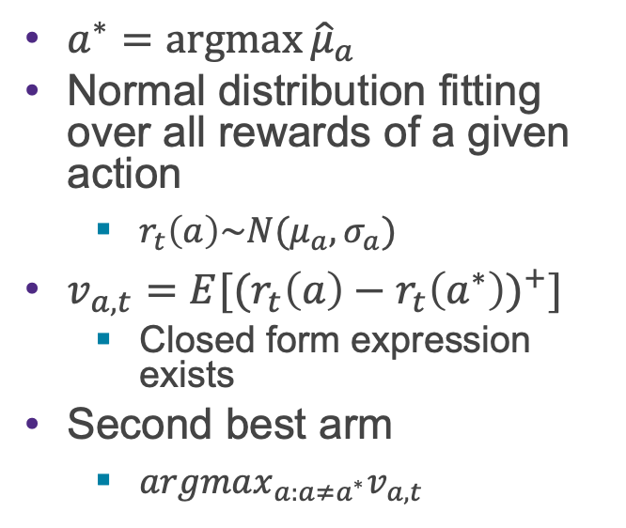
Top-two Expected Improvement
Idea
  Use best arm with certain probability
  Use second best arm otherwise
Definition of second best
  Second best with respect to empirical mean
    Does not work well
  Capture improvement from best arm
    Disregard when worse than best arm
    Account when better than best arm
$a^{∗}=\operatorname{argmax}{{\hat{μ}}_{a}}$
Normal distribution fitting over all rewards of a given action
  $r_{t}\left(a\right)\sim N(μ_{a},σ_{a})$
$v_{a,t}={E[(r}_{t}\left(a\right)−r_{t}{\left(a^{∗}\right))}^{+}]$
  Closed form expression exists
Second best arm
  $argmax_{a:a≠a^{∗}}v_{a,t}$

Slide 22
Reusability

Slide 23
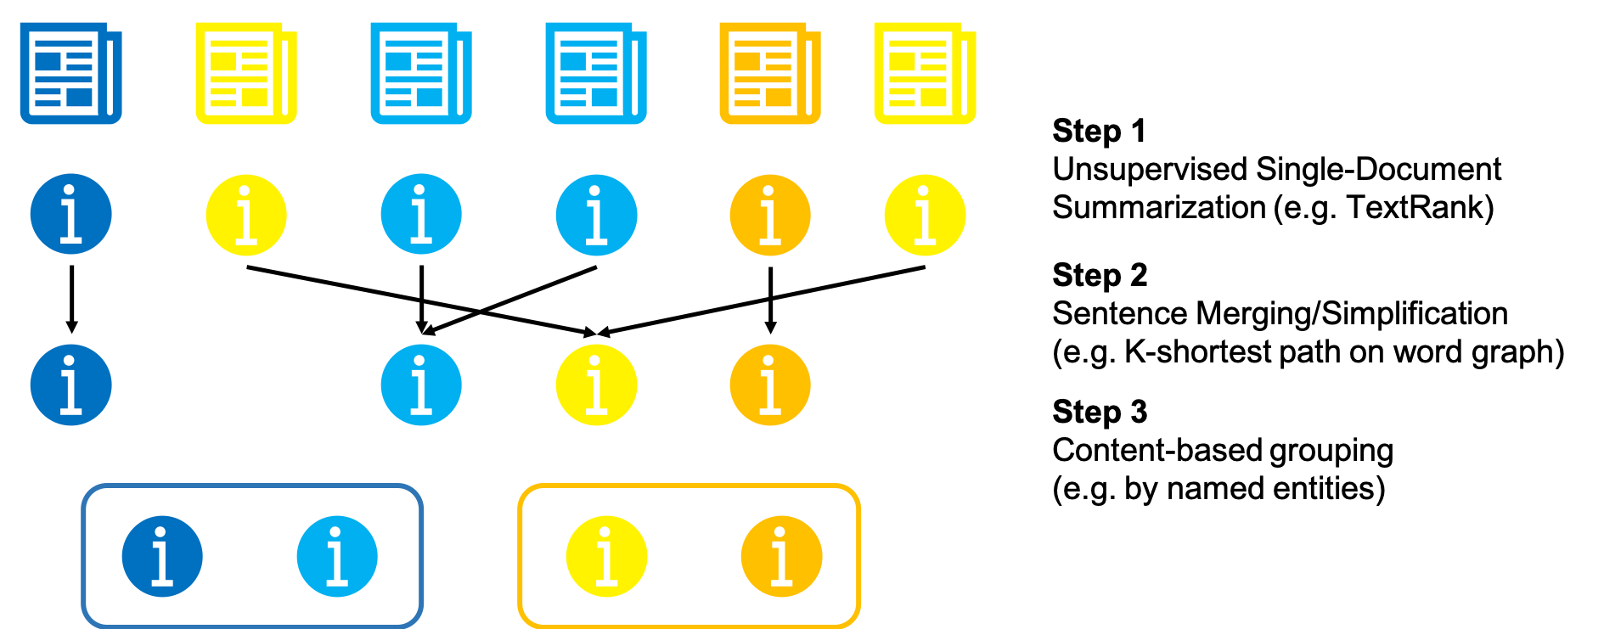
Unsupervised Abstractive Multi-Document Summarization

Slide 24

Thank you!
@dklabjan
Sorry if I missed your tweet or Friday lunch!

