Slide 1
An Introduction to product archaeology
Helping Students to Consider Non-Technical Factors in Their Engineering Design Decisions
David Gatchell, Director, MaDE Program, Clinical Associate Professor in Biomedical Engineering, Mechanical Engineering
Wei Chen, Wilson-Cook Professor in Engineering Design and Professor of Mechanical Engineering
Presentation to the NCEER Community, April 24th, 2013

Slide 2
Product dissection activities have become increasingly popular over the past 20+ years
Spurred by Sheri Sheppard’s ME 99: Mechanical Dissection course at Stanford, these activities …
Provide “hands-on” experiences in the classroom
Anchor the knowledge and practice of engineering
Identify relationships among engineering fundamentals and product (hardware) design
Increase awareness of the design process

Slide 3
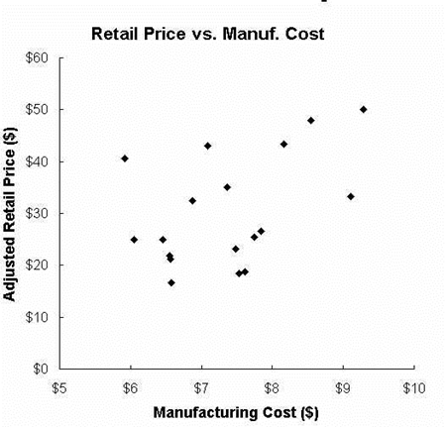
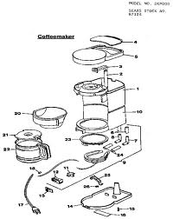
Product dissection activities can facilitate in-depth investigation of manufacturing costs
Ulrich & Pearson considered 18 coffee makers from 9 manufacturers
Cost to manufacture: $5.92 to $9.28 (adjusted for features)
Retail price: $16.60 to $50.00 (adjusted for features)
Retail price (customer perception is independent of manufacturing cost)
Conclusion: design matters

Slide 4
Ulrich and Pearson coined the phrase “product archaeology”
Principal focus of study
“… measure the manufacturing content … through analysis of the physical products themselves, and to estimate how variation in manufacturing content related to variation in cost in a hypothetical manufacturing setting. We call this approach product archaeology¹.”
¹Ulrich and Pearson, Management Science, 44:3, March 1998

Slide 5
Chen, Lewis & Simpson (and others) investigated whether product dissection activities facilitate understanding of GSEE factors
Motivated by ABET Outcome (h): “the broad education necessary to understand the impact of engineering solutions in a global, economic, environmental, and societal context”
Supported by NSF
CI-TEAM Implementation Project: A National Engineering Dissection Cyber-Collaboratory (1/2007 – 12/2008)
CCLI Phase II: Collaborative Research - Teaching the Global, Economic, Environmental, and Societal Foundations of Engineering Design through Product Archaeology (9/2009 – 9/2011
TUES Collaborative Research: Assessment of Product Archaeology as a Platform for Contextualizing Engineering Design (9/2012 – 8/2014)

Slide 6
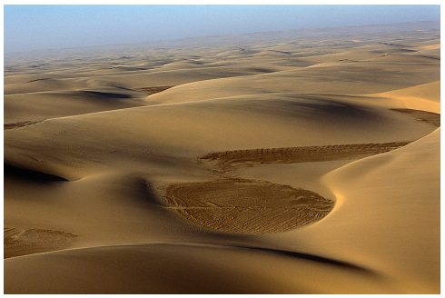
Contextual Analysis (GSEE)
ABET outcome (h)
“…the broad education necessary to understand the impact of engineering solutions in a global, economic, environmental, and societal context”
Goals of contextual analysis
Better define design needs/objectives
Help develop design solutions that address the contextual aspects
Traditionally the needs have been defined by the physical operating conditions

Slide 7
Definitions of the Four Factors
Factor one: Global
Design considerations that result from cultural and geographic traits specific
to a region or originating from the interaction between two or more
culturally/geographically distinct regions.
Factor two: Economic
Design considerations that result from the economic conditions at the time of
a product’s development and its past, present and projected sales and
support life cycle.
Notes:
.

Slide 8
Definitions of the Four Factors
Environmental Factors:
Design considerations that result from the environmental impact during the
product’s development, manufacturing, sales, operation and disposal
(cradle-to-grave or cradle-to-cradle)
Societal Factors:
Design considerations that result from considering the impact on the people
and society within which a product is being used; these include issues such as safety, ergonomics, and lifestyle

Slide 9
Redefining product archaeology
By considering products as designed artifacts with a history rooted in their development, we will synthesize concepts from archaeology with advances in cyber-enhanced product dissection to implement new educational innovations that integrate global, economic, environmental, and societal concerns into engineering design-related courses using product archaeology.

Slide 10
4 Phases in an Archaeological Dig
Preparation
Excavation
Evaluation
Explanation

Slide 11
Mapping between Archaeological Exploration Phases and Kolb’s 4-stage Learning Model
Archaeological Approach
to a Site
Preparation
Survey the site
Gather tools, etc.
Historic research
Excavation
Dig and extract
Collect specimens
Evaluation
Identify available technology
Carbon dating/chronology
Analyze found artifacts, food, tools, art etc.
Explanation
Draw conclusions based on gathered evidence
Kolb’s 4-Stage
Learning Model
Reflective Observation
Conduct product research
Plan dissection process
Investigate product lifecycle
Concrete Experience
Dissect the product
Reverse engineering
Active Experimentation
Ask “what if” type questions
Benchmark other products
Conduct product and material experiments
Abstract Conceptualization
Draw conclusions based on gathered evidence

Slide 12
Template for developing product-based archaeological exercises: Preparation
Stage | Outcome addressed | Kolb’s Learning Style
Preparation: Based on a description of the artifact, address the following issues
1) Describe the purpose of the product, how it works, the intended global market segments, and how cultural needs are addressed with the product | Global | Reflective Observation
2) What were the economic conditions are the time this product was designed and manufactured and how are economic issues reflected in the design of the product? | Economic
3) What were the planned environmental impacts of this product and what were the environmental factors engineers had to consider in the design of the product? | Environmental
4) What was the planned impact of the product on the culture and lifestyles of the customer base? | Societal

Slide 13
Template for developing product-based archaeological exercises: Excavation
Stage | Outcome addressed | Kolb’s Learning Style
Excavation: Based on a description of the artifact, address the following issues
1) Observe how people with different cultures and demographics use the product and then describe the functions that the product fulfills. | Global/Societal | Concrete Experience
2) Dissect the product, noting each step, tools used, and the ease/difficulty involved. | Societal/ Economic
3) For each major component or group of components, determine the material type, and manufacturing process used. | Economic/ Environmental
4) Determine the primary function of each major component or group of components, noting how its structural form helps fulfill its function. | Global/Societal

Slide 14
Template for developing product-based archaeological exercises: Evaluation
Stage | Outcome addressed | Kolb’s Learning Style
Evaluation: Based on your excavation process, address the following issues
1) What are the intended global market segments, and how are cultural needs addressed with the product? | Global | Active Experimentation
2) What were the economic conditions at the time this product was designed/manufactured, what were the competing products, and how are economic issues reflected in the design of the product? | Economic
3) What were the actual environmental impacts of this product and what were the environmental factors engineers had to consider in the design of the product? | Environmental
4) What was the actual impact of the product on the culture and lifestyles of the customer base? | Societal

Slide 15
Template for developing product-based archaeological exercises: Explanation
Stage | Outcome addressed | Kolb’s Learning Style
Explanation: Address the following implementation issues, considering current and future conditions
1) How does the company address global market needs in the design of their current line of products? How could it address these issues better in future global product lines? | Global | Abstract Conceptualization
2) Given current economic conditions, what could engineers do to enhance the economic impact of the product on the company? | Economic
3) How could the company reduce the cradle to cradle environmental impact in future products and product lines? | Environmental
4) How could the company address social use issues such as safety, ergonomics, product use experiences, and lifestyle impact better in future products? | Societal

Slide 16
Framework for Classifying Product Dissection-based Activities
Expose:
1st and 2nd year courses
Familiarize students with products and artifacts in
a structured way
Teach engineering terminology and vocabulary
Highly structured to help students overcome anxiety with the engineering field
Notes:
DTC)

Slide 17
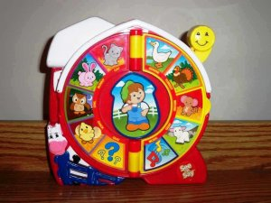
Framework for Classifying Product Dissection-based Activities
Expose: See ‘n Say Toy
Consider the early design of the Farmer Says® See ‘n Say Model
Compare the level of technology, environmental impact, and lifestyle influence to the current model.
Provide recommendations for how the design of the current See and Say could improve on at least one of these dimensions.

Slide 18
Framework for Classifying Product Dissection-based Activities
Inspire:
1st and 2nd year courses
Introduce design, graphics
Reinforce fundamentals from basic engineering courses
Statics and/or Mechanics of Materials
Less structure to promote self-discovery

Slide 19
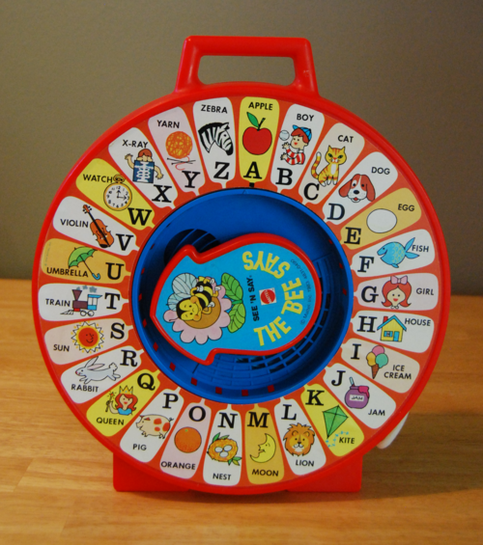
Framework for Classifying Product Dissection-based Activities
Inspire: See ‘n Say Toy
Using other resources, including the cyber-collaboratory, compare and contrast the various See ‘n Say models.
How do these differences address different cultural, economic, and environmental needs around the globe?

Slide 20
Framework for Classifying Product Dissection-based Activities
Inquire
3rd and 4th year courses
Hands-on activities
Reinforce engineering principles and theory
Highly structured to ensure proper delivery

Slide 21
Framework for Classifying Product Dissection-based Activities
Inquire: See ‘n Say Toy
Design a brand new See ‘n Say model that minimizes energy use and environmental impact while maximizing the potential market globally.
Be sure to consider educational content, evolution of technology, and social use.

Slide 22
Framework for Classifying Product Dissection-based Activities
Explore
3rd and 4th year courses
Hands-on activities
Reinforce engineering principles and theory
Highly structured to ensure proper delivery

Slide 23
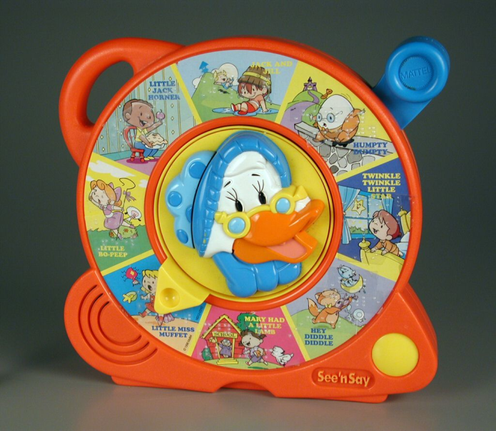
Framework for Classifying Product Dissection-based Activities
Explore: See ‘n Say Toy
Design a global platform for See ‘n Say toys that can be customized to a wide array of cultures, markets, and educational uses.
The platform will include a common product architecture that is flexible enough to accommodate diverse needs.

Slide 24
Interventions AT NU
ME 240
ME 398
DSGN 106-1,2
DSGN 298/398
DSGN 395

Slide 25
Interventions AT NU: ME 398
Product Archaeology Resources Assignment
Product Dissection Postulation
Product Dissection Lab and Report
Other deliverables
Conceptual Design Presentation
PDS
Detailed Design
Quiz(es)
Final Report

Slide 26
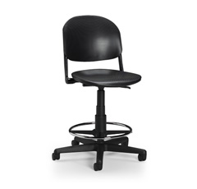
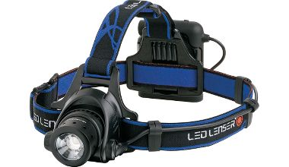
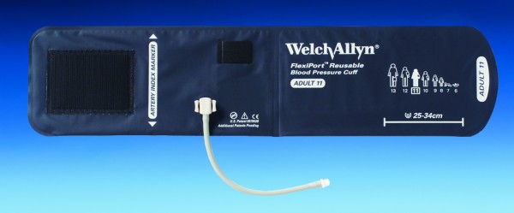
Product Dissection Lab - 2012

Slide 27
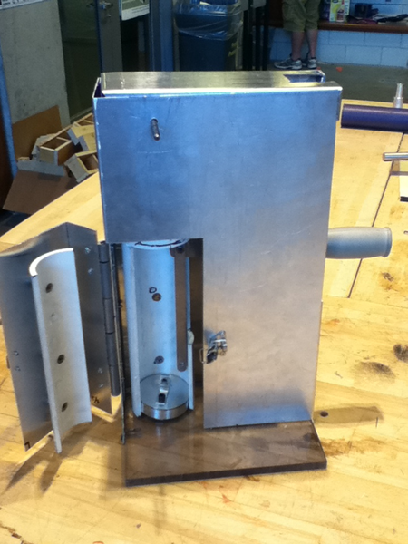
Comparison of dissected products and engineered solutions - 2012
Polyethylene Terephthalate (PET) Bottle Crusher

Slide 28
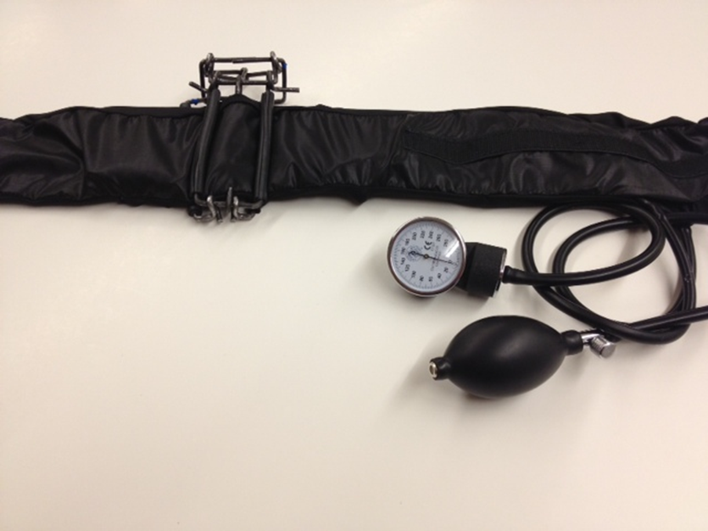
Comparison of dissected products and engineered solutions - 2012
Pediatric Blood Pressure Cuff

Slide 29
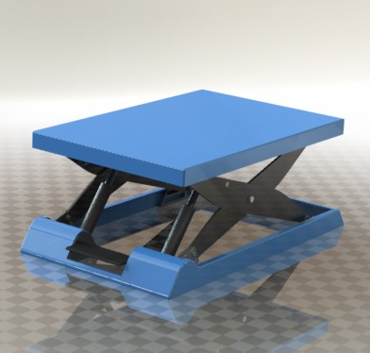
Comparison of dissected products and engineered solutions - 2012
MedStep

Slide 30
Rate how well contextual analysis introduced in this course helped you in the following aspects of your design project.

Slide 31
Pre/post survey for product archaeology assessments
1. SELF-EFFICACY (DEGREE OF CONFIDENCE)
DIRECTIONS: Rate your current degree of confidence (i.e. belief in your current ability) to perform the following tasks by marking a number from 0 to 100.
0 = cannot do at all → 100 = highly certain can do
 | 0 | 10 | 20 | 30 | 40 | 50 | 60 | 70 | 80 | 90 | 100
1. Conduct engineering design | ☐ | ☐ | ☐ | ☐ | ☐ | ☐ | ☐ | ☐ | ☐ | ☐ | ☐
2. Identify a design need | ☐ | ☐ | ☐ | ☐ | ☐ | ☐ | ☐ | ☐ | ☐ | ☐ | ☐
3. Research a design need | ☐ | ☐ | ☐ | ☐ | ☐ | ☐ | ☐ | ☐ | ☐ | ☐ | ☐
4. Develop design solutions | ☐ | ☐ | ☐ | ☐ | ☐ | ☐ | ☐ | ☐ | ☐ | ☐ | ☐
5. Select the best possible design | ☐ | ☐ | ☐ | ☐ | ☐ | ☐ | ☐ | ☐ | ☐ | ☐ | ☐
6. Construct a prototype | ☐ | ☐ | ☐ | ☐ | ☐ | ☐ | ☐ | ☐ | ☐ | ☐ | ☐
7. Test a design | ☐ | ☐ | ☐ | ☐ | ☐ | ☐ | ☐ | ☐ | ☐ | ☐ | ☐
8. Evaluate test data | ☐ | ☐ | ☐ | ☐ | ☐ | ☐ | ☐ | ☐ | ☐ | ☐ | ☐
8. Communicate a design | ☐ | ☐ | ☐ | ☐ | ☐ | ☐ | ☐ | ☐ | ☐ | ☐ | ☐
9. Redesign | ☐ | ☐ | ☐ | ☐ | ☐ | ☐ | ☐ | ☐ | ☐ | ☐ | ☐
10. Choose appropriate materials for a design | ☐ | ☐ | ☐ | ☐ | ☐ | ☐ | ☐ | ☐ | ☐ | ☐ | ☐
11. choose appropriate manufacturing processes for a design | ☐ | ☐ | ☐ | ☐ | ☐ | ☐ | ☐ | ☐ | ☐ | ☐ | ☐
12. collect stakeholder feedback on a design | ☐ | ☐ | ☐ | ☐ | ☐ | ☐ | ☐ | ☐ | ☐ | ☐ | ☐
13. analyze stakeholder feedback on a design | ☐ | ☐ | ☐ | ☐ | ☐ | ☐ | ☐ | ☐ | ☐ | ☐ | ☐
14. use mathematical modeling to represent a design | ☐ | ☐ | ☐ | ☐ | ☐ | ☐ | ☐ | ☐ | ☐ | ☐ | ☐
When responding to the above questions, what engineering tasks came to mind?
Engineering design task(s): ________________________________________________________________

Slide 32
Pre/post survey for product archaeology assessments
2. ENGINEERING CONTEXTS
DIRECTIONS: In the following section, you will be asked to rate your skill level and abilities. If you’re unfamiliar with, or have had no experience with, any of these, select the “Weak/none” option.
 | Weak/ none | Fair | Good | Very Good | Excellent
1. Knowledge of contexts (social, political, economic, cultural, environmental, ethical, etc.) that might affect the solution to an engineering problem | ☐ | ☐ | ☐ | ☐ | ☐
2. Knowledge of the connections between technological solutions and their implications for the society or groups they are intended to benefit. | ☐ | ☐ | ☐ | ☐ | ☐
3. Ability to use what you know about different cultures, social values, or political systems in developing engineering solutions. | ☐ | ☐ | ☐ | ☐ | ☐
4. Ability to recognize how different contexts can change a solution. | ☐ | ☐ | ☐ | ☐ | ☐
.
4. DEMOGRAPHICS
Name: _______________________________
Date: ______________________
Gender (circle): Male Female
Course Title and Name:
Institution:
Major:
Current Class Standing:
Freshman
Sophomore
Junior
Senior
Post-Baccalaureate

Slide 33
Contextual Analysis Assignment “Prosthetics” NU – DSGN 106-1, Fall 2012
Directions: Please complete each of the following questions fully. There are no right or wrong answers. Simply answer the questions to the best of your ability.
List ALL of the factors that you envision influencing your design for this course and explain why they are important.
In what ways to you think the factors that you listed above are similar to and different from:
Your friends?
Individuals in different parts of the US?
Individuals in different countries?

Slide 34
Product Archaeology Assessment “Prosthetics” NU – DSGN 106-1, Fall 2012
Design Challenge:
You have asked to design the next generation of upper-limb products for the company DTC Prosthetics.
List all the factors you need to consider that would influence your design decisions.
Describe how you would go about developing a solution to this design.

Slide 35
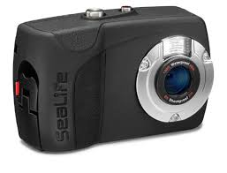
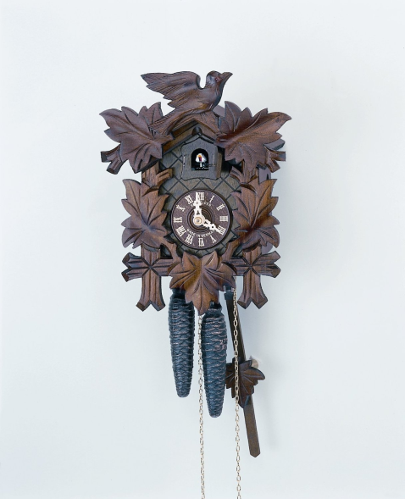
Product Dissection Lab - 2013

Slide 36
Notes:
Add significance results

Slide 37
**
**
Notes:
Add significance results

Slide 38
Dissemination plans
TUES* Type 3 project
Support large scale projects (max 5 years, $5M)
Emphasize dissemination and evaluation across a broad spectrum
2014 – 2019
Across universities
Across disciplines
*TUES = Transforming Undergraduate Education in STEM
(formally CCLI = Course, Curriculum, and Laboratory Improvement)

Slide 39
Dissemination plans - Goals
Goal 1: Coordinate a networked community of users
Goal 2: Promote PA through inter-university collaborations, K-12 outreach, and other informal learning opportunities within the community
Foster nationwide adoption through faculty development, graduate and undergraduate student mentoring

Slide 40
Other than ABET outcome (h) are there other reasons to educate our students in these areas?
Profitability
Safety
Social implications
Sustainability implications

Slide 41
Limitations of GSEE analysis
Ulrich and Pearson performed a quantitative analysis of manufacturing and assembly costs
We do not have quantitative rubrics for G, S and V
Global – Downey’s work
S - ?
V – Masanet’s life cycle analysis?

Slide 42
GSEE Lenses provide perspective
Students may consider GSEE factors indirectly, but formalizing the process has value.
Examples:
Asking DTC students to consider societal factors really emphasized the importance of the aesthetics in their designs.
Asking DSGN 298/398 students to consider environmental factors forced them to evaluate their choice of materials.
Asking ME 398 students to consider economic factors caused students to be more aware of budgets for all stakeholders involved.

