Slide 1


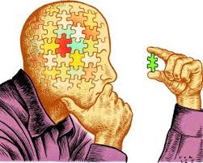

Assessing and Enhancing Critical Thinking Skills in the Laboratory and Science/Engineering Classroom
Matt Grayson, Josh Leonard,
& Denise Drane
Support for this work was provided by the National Science Foundation’s TUES Program: grant 942404.

Slide 2
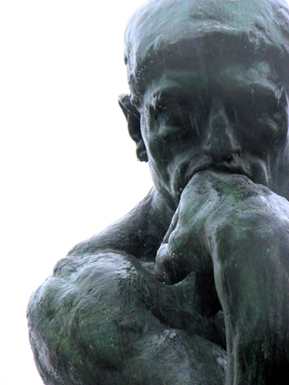
Overarching Questions
What is critical thinking?
What does it look like in science and engineering?
How we can we assess it?
How can we promote it?

Slide 3

Session Overview
Describe NSF funded study on critical thinking
Reflect on experience of being in the study
Review a way of defining critical thinking
Review assessments of critical thinking
Design a critical thinking assessment
Review ways of promoting critical thinking

Slide 4



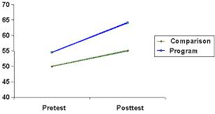
Study Design
Summer 2010
Fall 2010
Summer 2011
Fall 2011
What is critical thinking?
How can you measure it?
How much does student’s critical thinking usually improve?
Faculty teach as usual
Students take tests at beginning and end of the quarter
How do you teach to improve critical thinking?
Can we increase gains in critical thinking by changing teaching?
Faculty teach with new methods
Students take tests at beginning and end of quarter

Slide 5
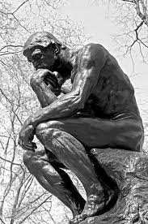
Some Reflections

Slide 6
Critical Thinking Skills
Evaluation of Information
Creative Thinking
Learning &
Problem Solving
Communication
Notes:
These are the skill areas that the CAT instrument is designed to assess. While faculty in each discipline do not necessarily consider all of these skill areas to be essential components of critical thinking, most faculty find at least 8 of the 12 skills to be important components of critical thinking.

Slide 7
Summarize the information presented in Figure 1
Some scientists believe that the prevalence of autism is increasing.
To what extent do the data in Figure 1 support the scientists’
beliefs?
Notes:
These are the skill areas that the CAT instrument is designed to assess. While faculty in each discipline do not necessarily consider all of these skill areas to be essential components of critical thinking, most faculty find at least 8 of the 12 skills to be important components of critical thinking.

Slide 8
3. Are there other possible explanations for the data in Figure 1
that would not necessarily support the idea that the
prevalence of autism is increasing in the US? Explain
Notes:
These are the skill areas that the CAT instrument is designed to assess. While faculty in each discipline do not necessarily consider all of these skill areas to be essential components of critical thinking, most faculty find at least 8 of the 12 skills to be important components of critical thinking.

Slide 9
4. What types of additional information would be necessary to
more fully evaluate the scientists’ hypothesis the prevalence of
autism has increased in the US between 1980 and 2010?
Try to identify three types of additional information and explain
how each would help evaluate the scientists’ hypothesis.
Notes:
These are the skill areas that the CAT instrument is designed to assess. While faculty in each discipline do not necessarily consider all of these skill areas to be essential components of critical thinking, most faculty find at least 8 of the 12 skills to be important components of critical thinking.

Slide 10
Critical Thinking Skills
Separate factual information from inferences.
Interpret numerical relationships in graphs.
Understand the limitations of correlational data.
Identify alternative interpretations for data or observations.
Identify new information that might support or contradict a hypothesis.
Notes:
These are the skill areas that the CAT instrument is designed to assess. While faculty in each discipline do not necessarily consider all of these skill areas to be essential components of critical thinking, most faculty find at least 8 of the 12 skills to be important components of critical thinking.

Slide 11
Design a wallet using this piece of paper.
2. List 3 factors that would lead you to change the design of the wallet.
Describe how you would alter your design in direct response to
a change in each factor?

Slide 12

  Explain how new information can change a problem.
  Communication
Notes:
These are the skill areas that the CAT instrument is designed to assess. While faculty in each discipline do not necessarily consider all of these skill areas to be essential components of critical thinking, most faculty find at least 8 of the 12 skills to be important components of critical thinking.

Slide 13
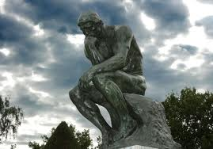
Critical thinking assessment questions in
Chemical and biological engineering
& Electrical Engineering

Slide 14
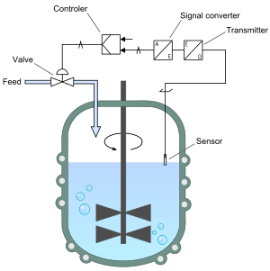
Chem. Eng. 341: “Dynamics & Control of Chemical and Biological Processes”
Course themes: mathematical analysis of processes that change in time, strategies for controlling process dynamics
Pedagogical goal: improve students’ ability to utilize and draw appropriate conclusions from empirical data
Students: ~30 senior ChE undergrads and a few MS
Source: Joshua Leonard, ChE 341 2012 & 2013

Slide 15
Designing assessment questions: critical thinking skills targeted
Summarize the pattern of results in a graph without making inappropriate inferences
Evaluate how strongly correlation-type data supports a hypothesis
Evaluate whether spurious information strongly supports a hypothesis
Identify additional information needed to evaluate a hypothesis

Slide 16
Example : Summarize the pattern of results in a graph without making inappropriate inferences
A control engineer is working in a chemical plant in which it has been determined that an existing chemical reactor must be outfitted with a new control scheme in order to keep the concentration of product produced by that reactor (C_{P}) within desired limits. The engineer hypothesized that it should be possible to modulate the product concentration by adjusting the rate at which the feed enters the reactor (F). In order to program the controller, the engineer must derive an equation that relates the quantities F and C_{P}. Therefore, the engineer performed an experiment in which F was adjusted to a particular value and held constant for 1 hour, then C_{P} was measured, and then F was adjusted to a new value, and so on in order to obtain the data plotted below (i.e., 6 such measurements were made).
Notes:
Need to consider the actual magnitude of the temperature. If the incinerator operates at 1500 F, this change might be meaningless. Eg., drift in the thermocouple.
What is the error associated with measurement? With the process?

Slide 17
Example : Summarize the pattern of results in a graph without making inappropriate inferences
A control engineer is working in a chemical plant in which it has been determined that an existing chemical reactor must be outfitted with a new control scheme in order to keep the concentration of product produced by that reactor (C_{P}) within desired limits. The engineer hypothesized that it should be possible to modulate the product concentration by adjusting the rate at which the feed enters the reactor (F). In order to program the controller, the engineer must derive an equation that relates the quantities F and C_{P}. Therefore, the engineer performed an experiment in which F was adjusted to a particular value and held constant for 1 hour, then C_{P} was measured, and then F was adjusted to a new value, and so on in order to obtain the data plotted below (i.e., 6 such measurements were made).
Notes:
Need to consider the actual magnitude of the temperature. If the incinerator operates at 1500 F, this change might be meaningless. Eg., drift in the thermocouple.
What is the error associated with measurement? With the process?

Slide 18
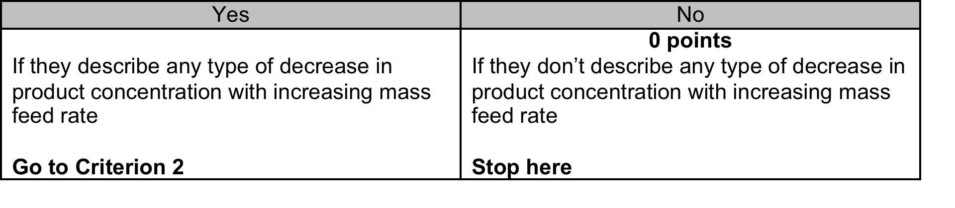
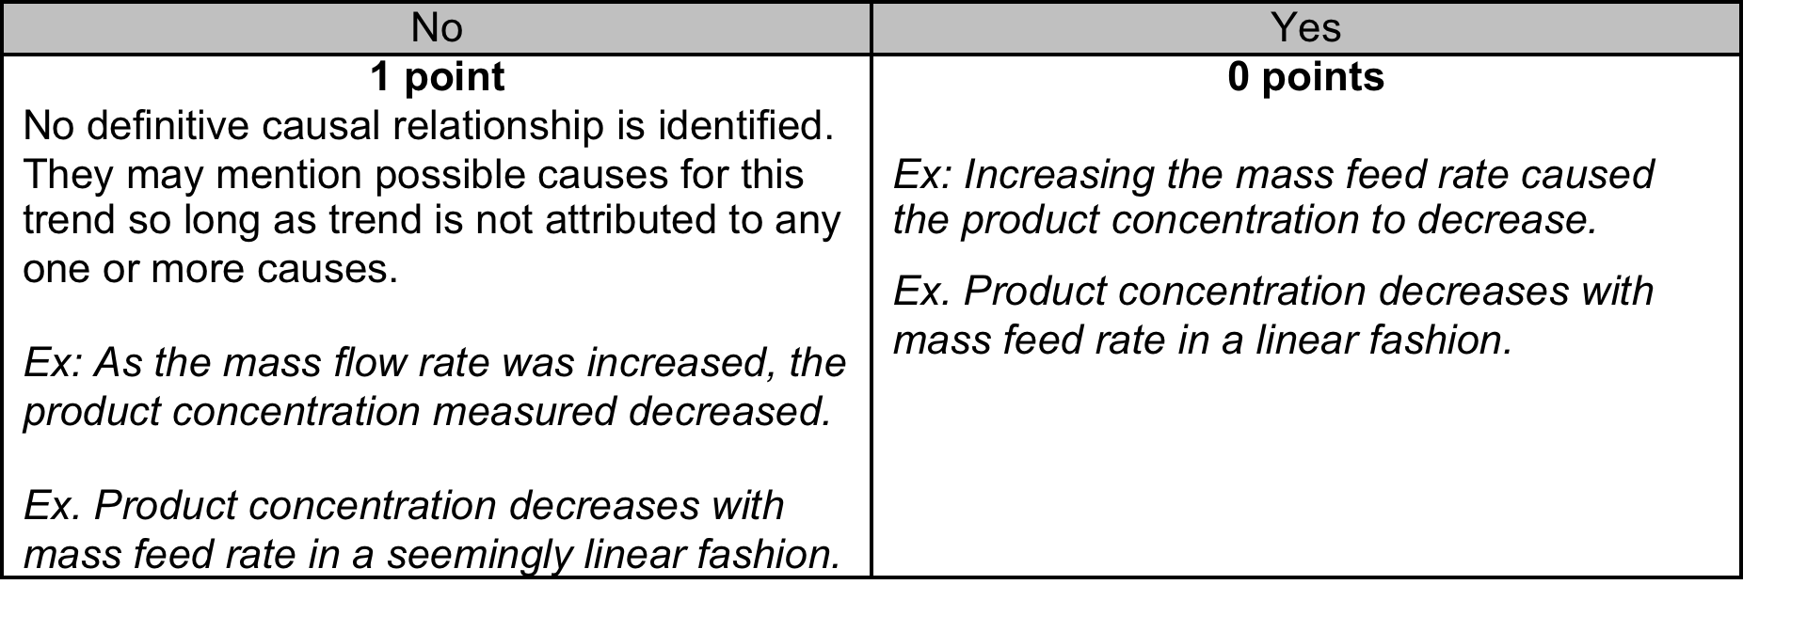
Example : Summarize the pattern of results in a graph without making inappropriate inferences
1. Summarize the information presented in Figure 1 above
Criterion 1: Can they can read the graph?
Criterion 2: Were inappropriate inferences made?
Notes:
Need to consider the actual magnitude of the temperature. If the incinerator operates at 1500 F, this change might be meaningless. Eg., drift in the thermocouple.
What is the error associated with measurement? With the process?

Slide 19
EECS 384: “Solid State
Electronic Devices”
Course themes: relating electronic materials properties to device operation
Pedagogical goal: improve students’ ability to work in groups and to solve critical thinking problems
Students: ~12 senior EECS undergrads and junior grads

Slide 20
SECTION I. Mark is a well-respected scientist in an industrial research laboratory who has invented a new processing technique which he argues can make useful electronic devices out of any thin layer of plastic polymer. The data shown below were taken from two samples processed on different days with completely different polymers that he has processed with the same technique. Both graphs were published in highly respected journals. However, no other scientists in the field have been able to reproduce these results, in spite of several years of attempts. Nancy is a colleague from a competing institution who has raised the question that this scientist may have falsified his data.

Slide 21
SECTION I. Mark is a well-respected scientist in an industrial research laboratory who has invented a new processing technique which he argues can make useful electronic devices out of any thin layer of plastic polymer. The data shown below were taken from two samples processed on different days with completely different polymers that he has processed with the same technique. Both graphs were published in highly respected journals. However, no other scientists in the field have been able to reproduce these results, in spite of several years of attempts. Nancy is a colleague from a competing institution who has raised the question that this scientist may have falsified his data.

Slide 22
1) What do you see in this data that may have contributed to Nancy’s suspicions of falcification?
ONE POINT EACH (UP TO 3 POINTS MAX) IF STUDENT MENTIONS THE FOLLOWING:
* Data curves look remarkably similar, virtually indistinguishable
* Values of voltage labels for curves are identical (-1V through -10V)
* Values of axes are the same except for a negative sign
EXAMPLES OF INCORRECT ANSWERS:
* That the graphs are “exactly identical”, which ignores the change of sign in the
x- and y-axes

Slide 23
2) A number of scientists who share the Nancy’s concerns have convened a panel of volunteer scientists drawn from five different universities and research centers to address this question of whether this data represents scientific misconduct or not. In defense of Mark, list examples of how this dataset might represent Mark’s honest representation of his scientific results.
ONE POINT EACH (UP TO 2 POINTS MAX) IF STUDENT MENTIONS THE FOLLOWING:
* Data may just happen to be identical, except for sign change of axes
* Electrical behavior may be by-product of processing technique, independent of polymer
* Mark may have accidentally mixed up the data
* The samples may have been intentionally designed to show the response observed
* The measurement equipment may have malfunctioned, generating false data

Slide 24
2) A number of scientists who share the Nancy’s concerns have convened a panel of volunteer scientists drawn from five different universities and research centers to address this question of whether this data represents scientific misconduct or not. In defense of Mark, list examples of how this dataset might represent Mark’s honest representation of his scientific results.
EXAMPLES OF INCORRECT ANSWERS:
* Mark is the only scientist capable of fabricating samples of this quality / others did not repeat the experiment correctly. (The issue is not that others cannot reproduce his data, the issue is why might the curves be so similar.)
* Compare to data in the logbook or conduct the experiment again. (The question is not how to validate Mark’s data, but how he may have honestly arrived at this data.)

Slide 25
3) The panel is authorized to contact Mark and make up to three different scientific requests of him to establish the validity of Mark’s results. List three examples that a panelist could request and explain how it could help to identify whether scientific misconduct took place.
ONE POINT EACH (UP TO 2 POINTS MAX) IF STUDENT MENTIONS THE FOLLOWING:
* Examine laboratory notebook
* View raw data
* Ask Mark to repeat the experiment and provide fresh data
* Ask for samples so that independent scientists can reproduce the data
* Allow outside observer to examine Mark’s processing and testing of a new sample

Slide 26
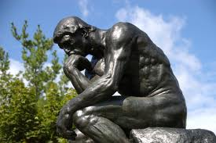
Designing Critical Thinking Questions
1. Choose a scenario from the examples listed.
2. Create 2 critical thinking questions based on the critical thinking skills list
3. Share with the larger group

Slide 27
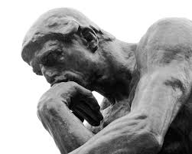
Activities to Promote Critical Thinking

Slide 28
Chem. Eng. 341: “Dynamics & Control of Chemical and Biological Processes”
Course themes: mathematical analysis of processes that change in time, strategies for controlling process dynamics
Pedagogical goal: improve students’ ability to utilize and draw appropriate conclusions from empirical data
Students: ~30 senior ChE undergrads and a few MS
Source: Joshua Leonard, ChE 341 2012 & 2013

Slide 29
In-class activity: critical thinking skills targeted
Summarize the pattern of results in a graph without making inappropriate inferences
Evaluate how strongly correlation-type data supports a hypothesis
Evaluate whether spurious information strongly supports a hypothesis
Identify additional information needed to evaluate a hypothesis
Completely aligned with critical thinking questions

Slide 30
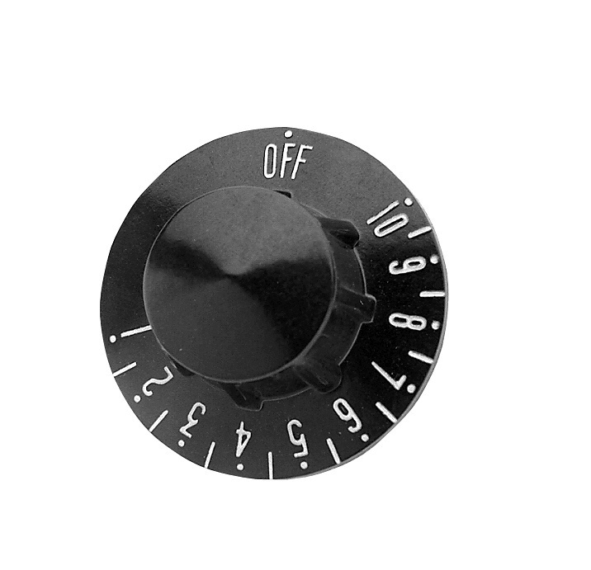

Innovation: Team-based critical thinking exercise using empirical data
Start with a set of “actual” experimental data
Goal: derive an empirical model of this process
Students work in teams of 3-4 to address prompts, discuss in teams and then as a class
incinerator

Slide 31
Summarize/interpret these data. What conclusions can be drawn?
How strongly do these data support the hypothesis that the system exhibits FODT behavior?
Notes:
Need to consider the actual magnitude of the temperature. If the incinerator operates at 1500 F, this change might be meaningless. Eg., drift in the thermocouple.
What is the error associated with measurement? With the process?

Slide 32
Propose an alternative hypothesis that your team finds most compelling, and then propose additional experiments that could be conducted to evaluate your hypothesis. Explain why these experiments would let you evaluate which of these two hypotheses is most supported.
Notes:
State anticipated results, and how you would interpret them
Have students formulate these answers in teams, then share and write answers upon on the board

Slide 33
Now you repeat the experiment and measure the new data (X) shown above. To what extent do these new data support the original hypothesis and each of the alternatives proposed?
Notes:
Use think-pair-share and then discuss as a class

Slide 34
Insights and observations
General belief: infallibility of data
  need models that “better fit the data”
Students initially lack the language to enunciate critical thinking analyses
  language improves quality and precision of analysis
Key benefits of in-class activity
  modeling critical thinking process and language
  feedback from peers and instructor
  expose and confront subconscious assumptions
Integration: follow up homework and final exam
  Definitely some reflection of activities, but heterogeneous

Slide 35
EECS 384: “Solid State
Electronic Devices”
Course themes: relating electronic materials properties to device operation
Pedagogical goal: improve students’ ability to work in groups and to solve critical thinking problems
Students: ~12 senior EECS undergrads and junior grads

Slide 36
Innovation: Quiz Teams
Learning objectives: critical thinking skills targeted
Develop dynamic group thinking skills
Develop awareness of multiple perspectives to each problem
Learn to present, defend, evaluate critical responses
Develop critical skills with different team partners

Slide 37
Innovation: Quiz Teams
Method
Students group into Quiz-Teams of 3 students each to discuss three problems in a period of 5-7 min.
Students use hole-punch to commit to multiple choice answers
Quiz-Teams discuss their answers and their reasoning for 3 min. with the entire class
Quiz-Team partners change every two quizzes

Slide 38
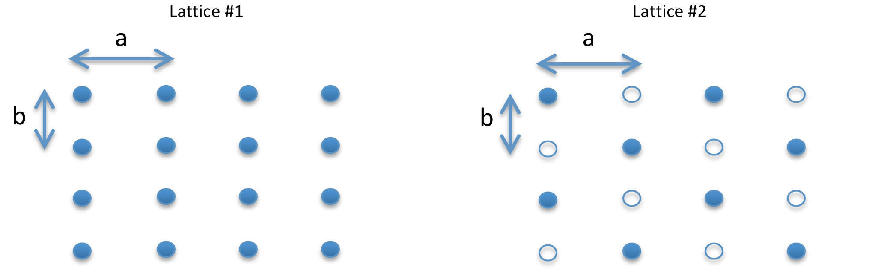
#1) For the following basis vectors, what is the unit cell volume?
A. a³
B. a³/2
C. 2a³
D. a³/4
Quiz Team Questions,
Round 1-A
#2) Select all point group symmetries (if any) that the left lattice has and the right
does not have:
reflection through a point about vertical axis
reflection through a point about horizontal axis
C. rotation through a point by 90 degrees
D. translation to the right by a
#5) Crystal systems are defined by point group symmetries alone, whereas Bravais
lattices are additionally defined by translational symmetries.
T. True
Insufficient Information
F. False

Slide 39
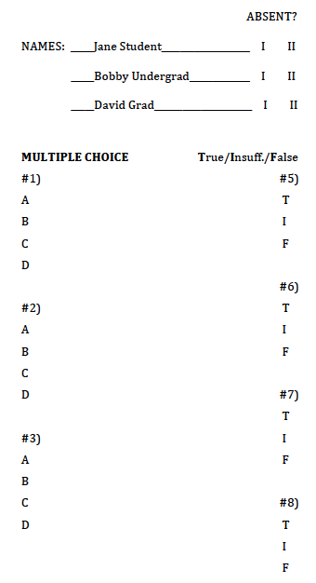
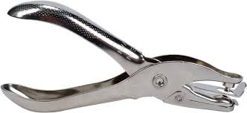
#1) For the following basis vectors, what is the unit cell volume?
A. a³
B. a³/2
C. 2a³
D. a³/4
Quiz Team Questions,
Round 1-A
#2) Select all point group symmetries (if any) that the left lattice has and the right
does not have:
reflection through a point about vertical axis
reflection through a point about horizontal axis
C. rotation through a point by 90 degrees
D. translation to the right by a
#5) Crystal systems are defined by point group symmetries alone, whereas Bravais
lattices are additionally defined by translational symmetries.
T. True
Insufficient Information
F. False

Slide 40
Quiz Teams:
Insights and observations
The students were engaged
  Spirited discussions
Group dynamics clearly affected the decision
  sometimes the loudest voices in a group would talk more timid ones away from the correct answer
High satisfaction with learning
  Even when student team got problem wrong, they seemed quite eager to hear discussions and justifications of the correct explanation
  seemed to recognize the missing piece which kept them from getting the correct answer when it was shown to them

Slide 41
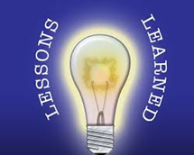
Lessons Learned
Key Areas to Assess
Ability to generate plausible alternatives
Belief in the infallibility of data
Communication of explanations & reasoning
Pedagogical Approaches
Model thinking
Question assumptions
Ask for written explanations and reasoning
Utilize peer feedback
Use real world examples
Benefits
Enhanced critical thinking
Greater satisfaction with learning
Enhanced creativity

Slide 42
Goals for us as scientists and for our students
Examine central issues and assumptions
Evaluate multiple perspectives
Recognize important relationships
Make correct inferences from evidence
Deduce conclusions from information or evidence
Interpret viability of conclusions, using evidence
Potts, 1994; Tsui, 2006

Slide 43
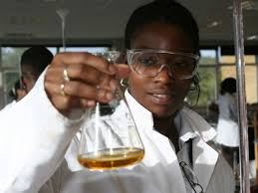
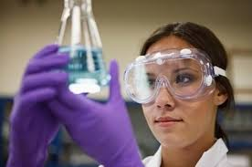
Goals for us as scientists and for our students
Evaluate evidence or authority
Look for--or create--new solutions
Reframe problems, issues, questions
Reflect on one’s own gaps, strengths, weaknesses
Potts, 1994; Tsui, 2006

