Slide 1
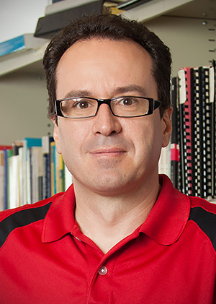
ESAM SEMINAR SPEAKER
Mathematical Modeling for the Rational Design of Synthetic Microbial Consortia
Kresimir Josic, Ph.D.
December 2nd, 2019 • 4 pm
M416 (ESAM Conference Room), Tech
Synthetic microbial consortia have a number of advantages over isogenic system as biochemical and regulatory tasks can be divided between the strains. However, the complexity of these systems makes it difficult to engineer them from scratch. Coordinating gene expression is particularly challenging in spatially extended consortia because the range of signaling molecules is limited by diffusion. I will discuss two examples where mathematical modeling and analysis allowed us to understand experimentally observed dynamics in such system, and use such modeling to control their behavior: First, I will show how modeling predicts that spatio-temporal coordination of gene expression can be achieved even when the spatial extent of a consortium is much greater than the diffusion distance of the signaling molecules. Experiments confirmed these observations, and the need for an intrinsic positive feedback loop that amplifies and propagates intercellular signals. In a second example, we built a three-strain consortium that pulses in response to an external signal. We also developed a computational model which predicts the system's behavior at different strain ratios, and can be used to control its dynamics. Our work thus shows that mathematical modeling can be used to rationally and predictably tune complex synthetic biological systems allowing us to engineer biology more rapidly.

