Slide 1
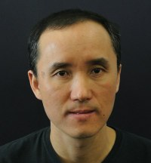
ESAM SEMINAR SPEAKER
Self-Organized Wiring of a Neuronal Network for Precise Timing in Songbird
Dezhe Z. Jin, Ph.D.
The Pennsylvania State University
November 11, 2019 • 4 pm
M416 (ESAM Conference Room), Tech
Songbird is a model organism for studying complex human vocalizations such as speech and singing. Used for courtship, birdsong consists of sequences of stereotypical syllables with precisely timed acoustic features. In this talk, I will present a computational model of a network in songbird premotor nucleus HVC for controlling the timing. Experiments support that bursting HVC projection neurons form a polychronous chain network, which is a feedforward structure that enables synchronous inputs to individual neurons even though the axonal delays between neurons are widely distributed. I will also show how newly born neurons in HVC of juvenile songbirds help to self-organize such a network through synaptic plasticity and spontaneous activity.

